Slide 1
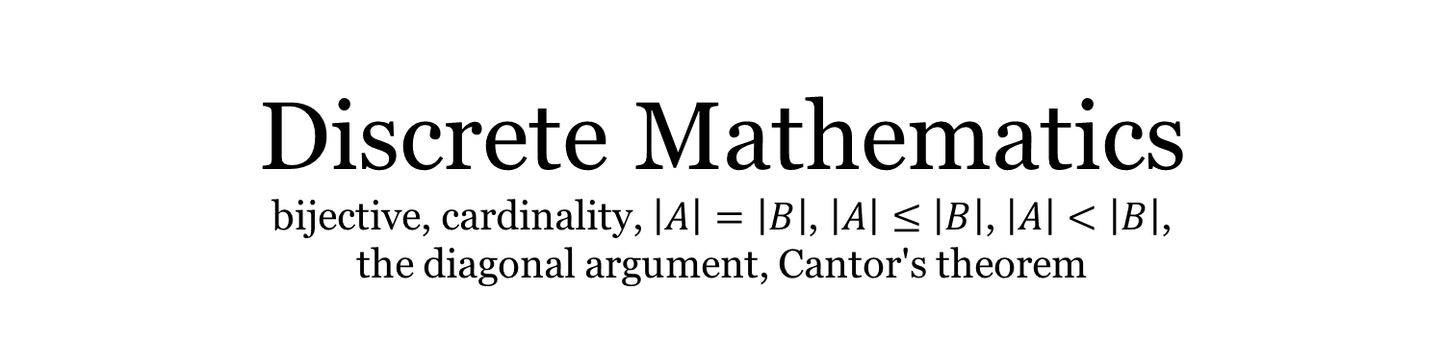
Discrete Mathematics bijective, cardinality, $\left|A\right|=\left|B\right|$, $\left|A\right|≤\left|B\right|$, $\left|A\right|<\left|B\right|$, the diagonal argument, Cantor's theorem
Liangfeng Zhang
School of Information Science and Technology
ShanghaiTech University

Slide 2
Combinatorics
Enumerative combinatorics
permutations, combinations, partitions of integers, generating functions, combinatorial identities, inequalities ……
Designs and configurations
block designs, triple systems, Latin squares, orthogonal arrays, configurations, packing, covering, tiling ……
Graph theory
graphs, trees, planarity, coloring, paths, cycles, ……
Extremal combinatorics
extremal set theory, probabilistic method……
Algebraic combinatorics
symmetric functions, group, algebra, representation, group actions……

Slide 3
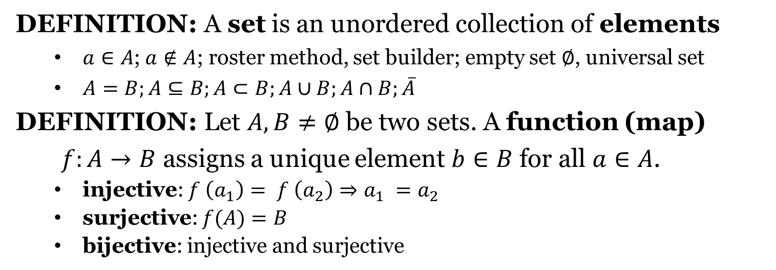
Sets and Functions
DEFINITION: A set is an unordered collection of elements
$a∈A$;$a∉A$; roster method, set builder; empty set ∅, universal set
$A=B;A⊆B;A⊂B;A∪B;A∩B;\overline{A}$
DEFINITION: Let $A,B≠∅$ be two sets. A function (map)
$f:A→B$ assigns a unique element $b∈B$ for all $a∈A$.
injective: $f \left(a_{1}\right)= f \left(a_{2}\right)⇒a_{1} =a_{2}$
surjective: $f(A)=B$
bijective: injective and surjective

Slide 4
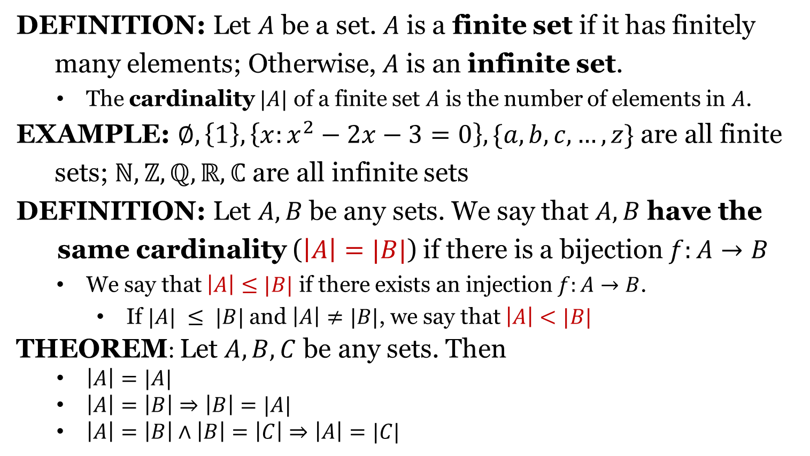
Cardinality of Sets
DEFINITION: Let $A$ be a set. $A$ is a finite set if it has finitely
many elements; Otherwise, $A$ is an infinite set.
The cardinality $|A|$ of a finite set $A$ is the number of elements in $A$.
EXAMPLE: $∅, \left\{1\right\}, \left\{x:x^{2}−2x−3=0\right\}, \{a,b,c,…,z\}$ are all finite
sets; $ℕ, ℤ, ℚ, ℝ, ℂ$ are all infinite sets
DEFINITION: Let $A, B$be any sets. We say that $A,B$ have the
same cardinality ($\left|A\right|=|B|$) if there is a bijection $f:A→B$
We say that $\left|A\right|≤|B|$ if there exists an injection $f:A→B$.
If $|A| ≤ |B|$and $\left|A\right|≠|B|$, we say that $\left|A\right|<|B|$
THEOREM: Let $A,B,C$ be any sets. Then
$\left|A\right|=|A|$
$\left|A\right|=\left|B\right|⇒\left|B\right|=|A|$
$\left|A\right|=\left|B\right|∧\left|B\right|=\left|C\right|⇒\left|A\right|=|C|$

Slide 5
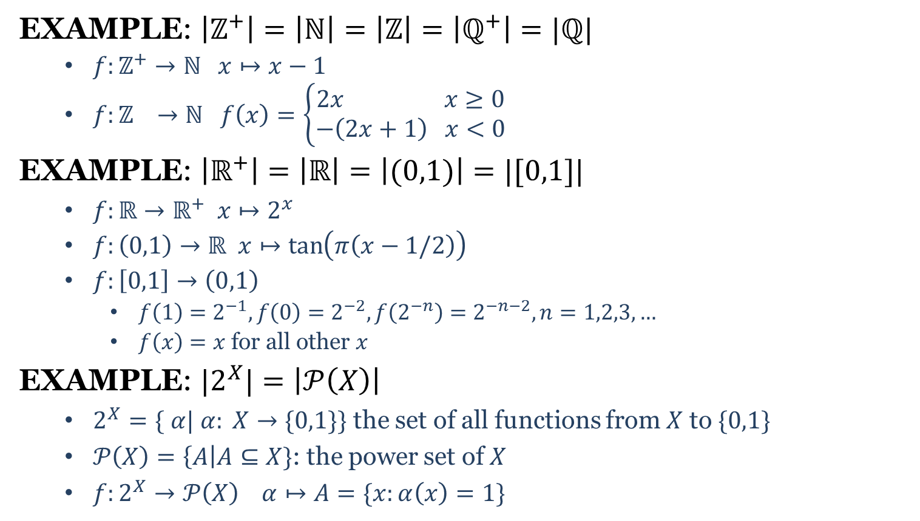

Cardinality of Sets
EXAMPLE: $\left|ℤ^{+}\right|=\left|ℕ\right|=\left|ℤ\right|=\left|ℚ^{+}\right|=|ℚ|$
$f:ℤ^{+}→ℕ x↦x−1$
$f:ℤ →ℕ f\left(x\right)=\left\{\begin{aligned}2x x≥0 \\ −\left(2x+1\right) x<0\end{aligned}\right.$
EXAMPLE: $\left|ℝ^{+}\right|=\left|ℝ\right|=\left|(0,1)\right|=|[0,1]|$
$f:ℝ→ℝ^{+} x↦2^{x}$
$f:\left(0,1\right)→ℝ x↦\tan\left(π\left(x−1/2\right)\right)$
$f:\left[0,1\right]→\left(0,1\right)$
$f\left(1\right)=2^{−1}, f\left(0\right)=2^{−2}, f\left(2^{−n}\right)=2^{−n−2}, n=1,2,3,…$
$f\left(x\right)=x$ for all other $x$
EXAMPLE: $|2^{X}|=\left|𝒫\left(X\right)\right|$
$2^{X}=\{$ $α| α: X→\{0,1\}\}$ the set of all functions from $X$ to $\{0,1\}$
$𝒫\left(X\right)=\left\{A\right|A⊆X\}$: the power set of $X$
$f:2^{X}→𝒫\left(X\right) α↦A=\{x:α\left(x\right)=1\}$
$f: ℤ^{+}$ $→$ $ℚ^{+}$

Slide 6
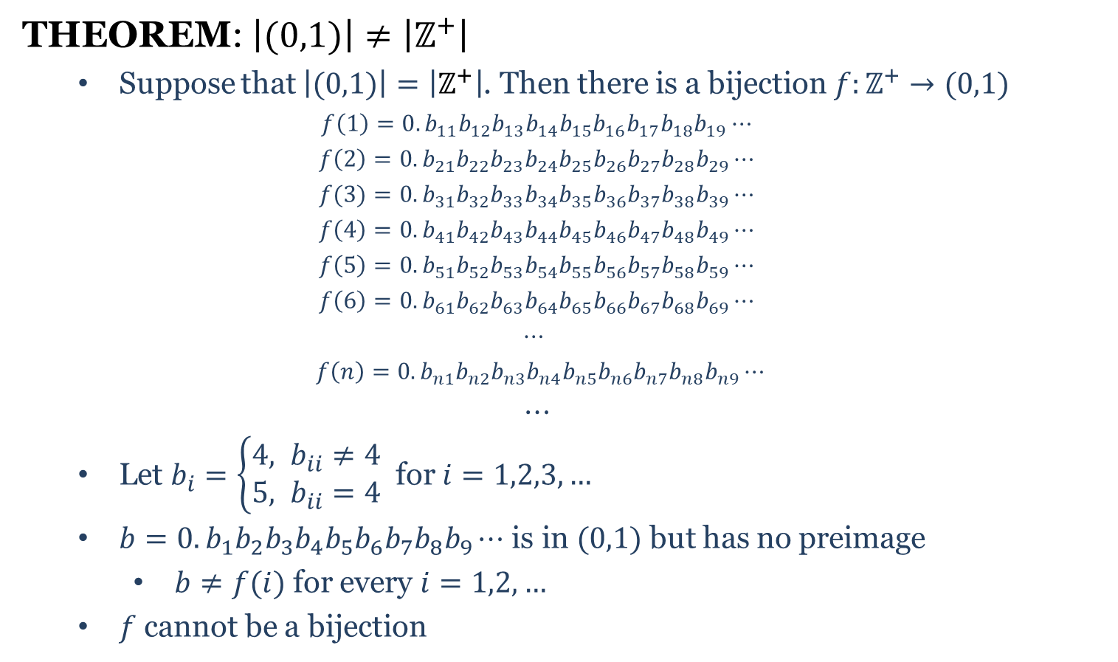
Cardinality of Sets
THEOREM: $\left|(0,1)\right|≠\left|ℤ^{+}\right|$
Suppose that $\left|(0,1)\right|=\left|ℤ^{+}\right|$. Then there is a bijection $f:ℤ^{+}→(0,1)$
$$f\left(1\right)=0.b_{11}b_{12}b_{13}b_{14}b_{15}b_{16}b_{17}b_{18}b_{19}⋯$$
$$f\left(2\right)=0.b_{21}b_{22}b_{23}b_{24}b_{25}b_{26}b_{27}b_{28}b_{29}⋯$$
$$f(3)=0.b_{31}b_{32}b_{33}b_{34}b_{35}b_{36}b_{37}b_{38}b_{39}⋯$$
$$f\left(4\right)=0.b_{41}b_{42}b_{43}b_{44}b_{45}b_{46}b_{47}b_{48}b_{49}⋯$$
$$f\left(5\right)=0.b_{51}b_{52}b_{53}b_{54}b_{55}b_{56}b_{57}b_{58}b_{59}⋯$$
$$f\left(6\right)=0.b_{61}b_{62}b_{63}b_{64}b_{65}b_{66}b_{67}b_{68}b_{69}⋯$$
$$⋯$$
$f\left(n\right)=0.b_{n1}b_{n2}b_{n3}b_{n4}b_{n5}b_{n6}b_{n7}b_{n8}b_{n9}⋯$
$$⋯$$
Let $b_{i}=\left\{\begin{aligned}4, b_{ii}≠4 \\ &5, b_{ii}=4\end{aligned}\right.$ for $i=1,2,3,…$
$b=0.b_{1}b_{2}b_{3}b_{4}b_{5}b_{6}b_{7}b_{8}b_{9}⋯$ is in $(0,1)$ but has no preimage
$b≠f(i)$ for every $i=1,2,…$
$f$ cannot be a bijection

Slide 7
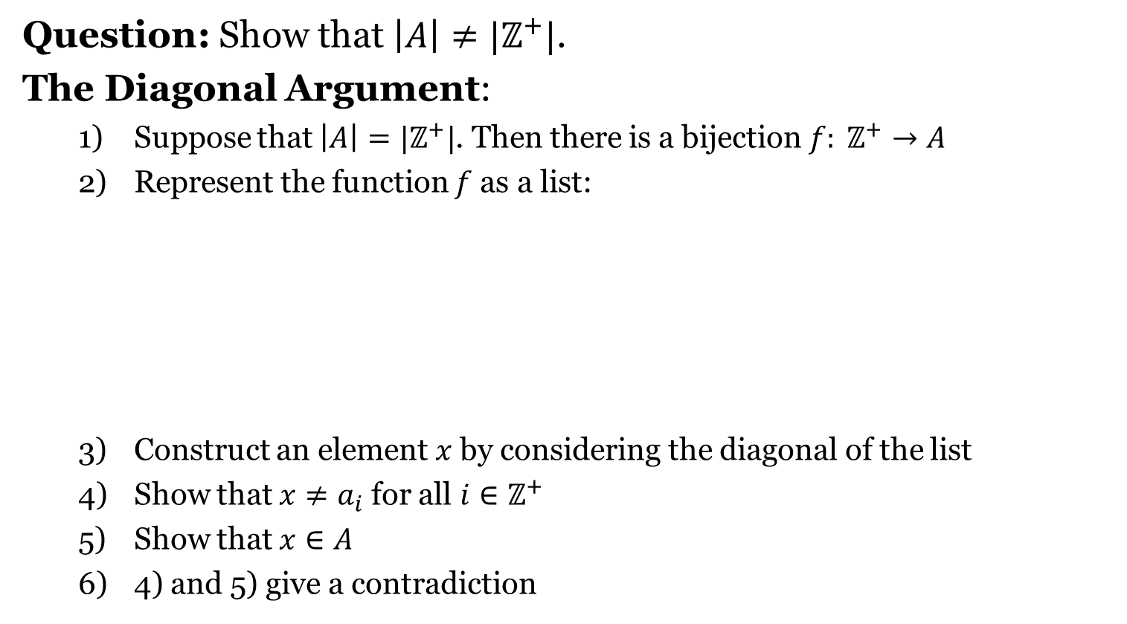

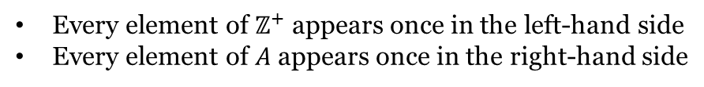
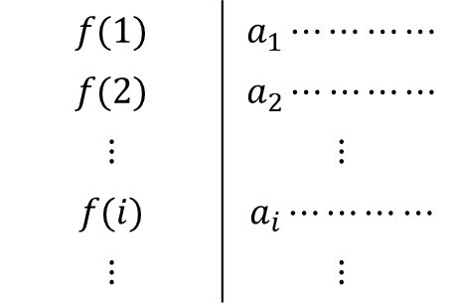
Cantor's Diagonal Argument
Question: Show that $\left|A\right|≠|ℤ^{+}|$.
The Diagonal Argument:
Suppose that $\left|A\right|=|ℤ^{+}|$. Then there is a bijection $f: ℤ^{+}→A$
Represent the function $f$ as a list:
Construct an element $x$ by considering the diagonal of the list
Show that $x≠a_{i}$ for all $i∈ℤ^{+}$
Show that $x∈A$
4) and 5) give a contradiction
$$f(1)$$ | $$a_{1}⋯⋯⋯⋯$$
$$f(2)$$ | $$a_{2}⋯⋯⋯⋯$$
$$⋮$$ | $$⋮$$
$$f(i)$$ | $$a_{i}⋯⋯⋯⋯$$
$$⋮$$ | $$⋮$$
Every element of $ℤ^{+}$ appears once in the left-hand side
Every element of $A$ appears once in the right-hand side
$$x$$

Slide 8
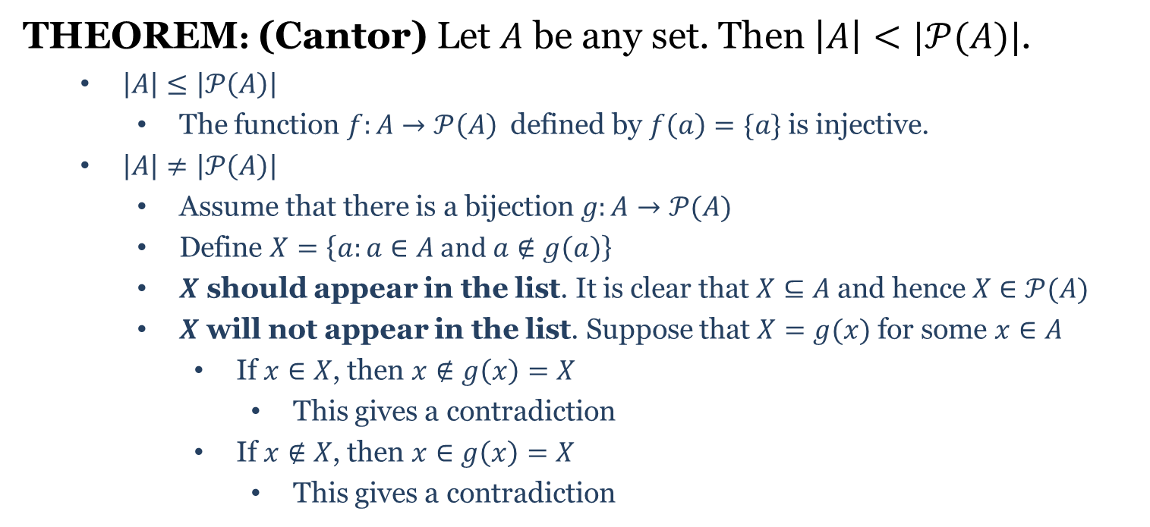
Cantor's Theorem
THEOREM: (Cantor) Let $A$ be any set. Then $\left|A\right|<|𝒫(A)|$.
$\left|A\right|≤\left|𝒫\left(A\right)\right|$
The function $f:A→𝒫\left(A\right)$ defined by $f\left(a\right)=\{a\}$ is injective.
$\left|A\right|≠\left|𝒫\left(A\right)\right|$
Assume that there is a bijection $g:A→𝒫(A)$
Define $X=\left\{a:a∈A and a∉g\left(a\right)\right\}$
$X$ should appear in the list. It is clear that $X⊆A$ and hence $X∈𝒫(A)$
$X$ will not appear in the list. Suppose that $X=g(x)$ for some $x∈A$
If $x∈X$, then $x∉g\left(x\right)=X$
This gives a contradiction
If $x∉X$, then $x∈g\left(x\right)=X$
This gives a contradiction

